Slide 1
Headlines You May Have Seen
Online attack hits US government Web sites (7 Jul 09)
Twitter DDoS Attack Politically Motivated, Says Report (7 Aug 09)
Four arrested in China over net-paralyzing gaming spat (2 Sep 09)
DDoS attacks topple 40 Swedish sites (30 Oct 09)
Study: DDoS attacks threaten ISP infrastructure (11 Nov 09)
Hacker grinches launch DDoS attack against Amazon (29 Dec 09)
Chinese Human Rights Sites Hit by DDoS Attack (25 Jan 10)
DDoS attacks, Network hacks rampant in oil & gas industry (28 Jan 10)
Intel Chief: U.S. at Risk of Crippling Cyber Attack (4 Feb 10)
Chinese ISP Momentarily hijacks the Internet (again) (8 Apr 10)
Attack of the Opt in Botnets (23 Apr 10)
Verisign Warns of growing denial-of-service threat (7 May 10)
Hackers Retaliate as Turkey’s censorship tightens (18 Jun 10)
[DDoS] BotNet spread by pressing one button… (2 Aug 10)
DNSMadeEasy Rallies After 50Gbps DDoS (9 Aug 10)
Notes:
In the past few years we have seen major cyber attacks on national infrastructures … 2007 on Estonia Government’s communications attacked by a Russian Youth Group attacks peaked at 2000 hps & ~80mbs and in 2008 attacks against Georgia’s IT infrastructure some peaking at ~800mbs. These were big news … this was the first time government communications were impacted by cyber assaults. This year it is difficult to pick up the paper without noticing attacks …. on Swedish Government websites, or commercial services like twitter, facebook or Google.

Slide 2
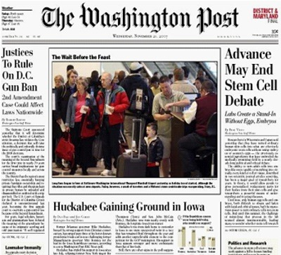


Headlines You DID NOT See
Independence Day Attacks Paralyze the U.S.
Government and Financial Websites Attacked and Taken Down: Stocks Show Concerns
President Delays Trip Due to Cyber Attacks

Slide 3
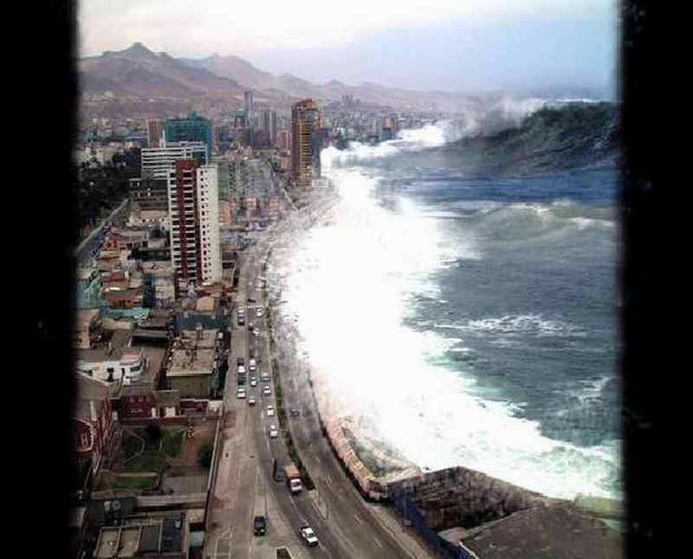
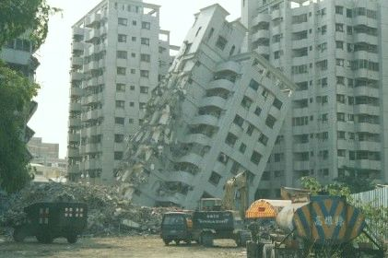
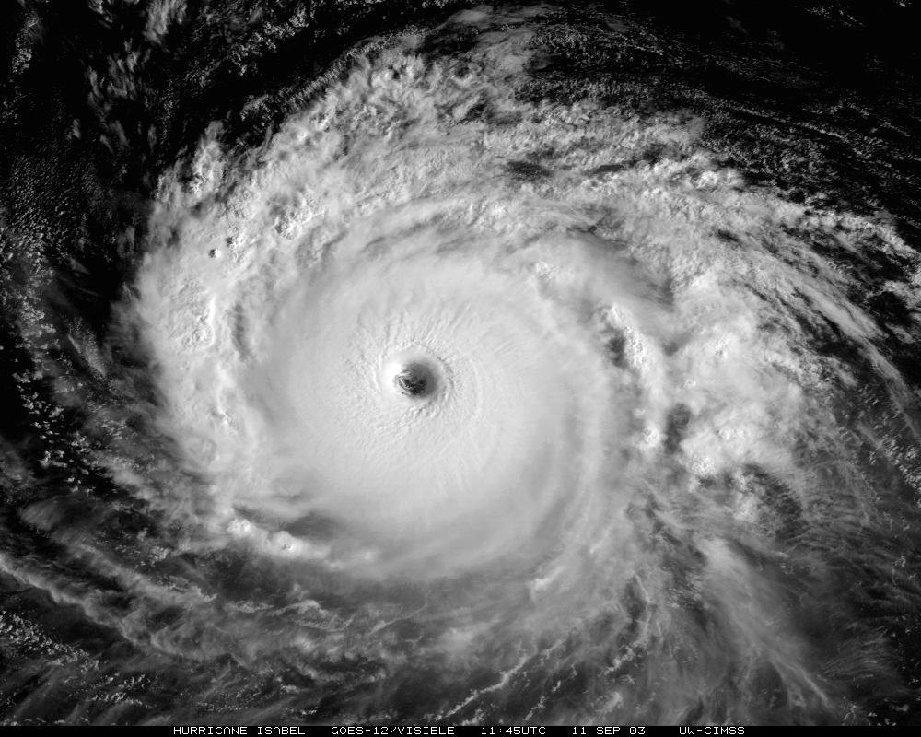

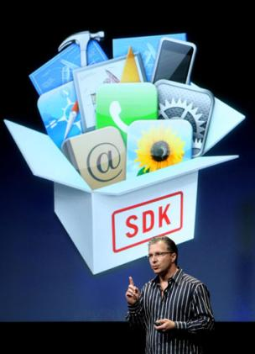
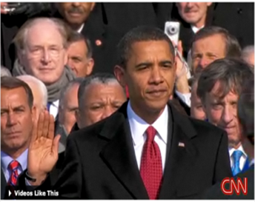


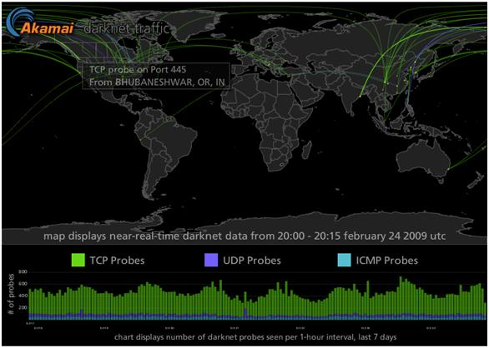
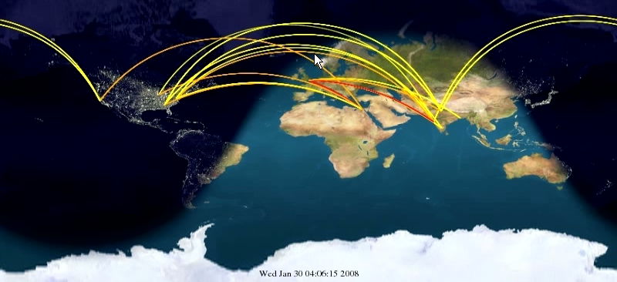
IT Risk In a Complex World
Notes:
As you all know, IT Infrastructure Risks can come in many different forms
Natural Disaster, hurricanes….earthquakes, tsunami…
Flash crowds resulting from Geopolitcal events, major product or software releases
OR Malicious and Intentional Attacks (Kinetic, or non-kinetic Malware, Viruses, DoS attacks, etc.)
…
THESE RISKS ARE REAL, AND THEY ARE NOT GOING AWAY

Slide 4


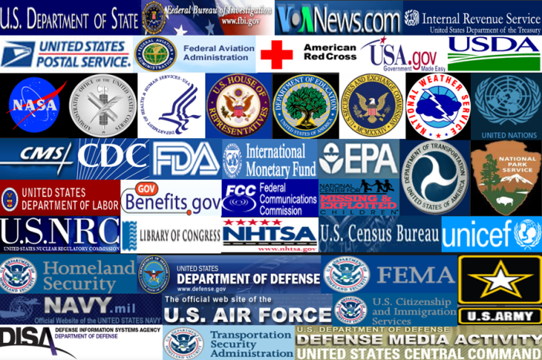


What’s At Risk?
Reputation & Brand
Dollars & Revenue
Mission & Trust
NSA's Guide: Defense in Depth - A practical strategy for achieving Information Assurance in today’s highly networked environments
Notes:
Reputation & Brand – Extremely valuable even in the public sector
Dollars and Revenue – Internal Revenue Service or the US Postal Services Army Air Force Exchange Service …. outages can be tied to dollars
Mission and Customer Trust – Most common with my customers is the ability to reliably make information available to the public. Through secure extranets and public sites.
Your Ability to Sleep
Significant factors in your success!
And although the fundamentals for securing your infrastructure remain the same, the distributed nature of the current threat requires a mitigation that is also distributed. …. and the threat continues to increase.

Slide 5
Weathering Storms in the Cloud: Analyzing Massive DDoS Attacks to Prepare for the Future
R. H. Powell IV
Senior Service Line Manager
August 10, 2010

Slide 6
Agenda
Weathering Storms in the Cloud
Is the Threat Worth Considering?
Data Collection & Considerations
Observations from the Wild
July 4th DDoS Case Study
How Do you Analyze This
Future Expectations & Innovation
Notes:
I will spend some time reviewing some of the risks to public facing sites and infrastructure, the challenges involved with mitigating those risks and then do a, deep dive into the July 4th DDoS attack against the US public Sector and finish up with a few of the lessons learned from that attack.

Slide 7
State of Internet Security Today
95% of corporate Web applications have severe vulnerabilities.¹
34 million computers in the U.S. alone may now be part of a botnet.²
Cybercrime costs businesses $1 trillion a year.³
In 2008, a Web page was infected every 4.5 seconds.⁴
Attack traffic observed from 198 countries in Q1 ‘10, up 291% from 68 countries in Q1 ‘09.⁵
¹ WASC ² Georgia Tech Information Security ³ McAfee ⁴ Sophos ⁵ Akamai
Notes:
In a March 2009 Forster Study 74% of the companies surveyed have been subject to DDOS in the last 12 months
Many think Bot networks made up of zombie computers are the greatest threat to IT infrastructure.
Yankee Group study of Tier 1 ISPs (Partridge, 2007), DDoS attacks ranked first on a list of security threats, with botnets a close second.
Forster reports that companies can experiences loses of $190k to $19m /hour of down time.
Gartner, reports that considers DDoS protection a cost of doing business for any organization that leverages the Internet.
This past May 2 of the worlds largest botnets run by organized crime showed uncharacteristic cooperation.
7

Slide 8
Targets of Opportunity
4000
3000
2000
1000
0
3,462
2,750
2,029
1,875
Volume of Vulnerabilities
2007
2008
2007
2008
(Non-Web Application Vulnerabilities)
(Web Application Vulnerabilities)
Source: Symantec Internet Security Threat Report, April 2009
Notes:
8
According to SANS Institute 60% of 2009 Attacks Targeted Web Infrastructure
Infoweek 64% of Attacks Targeted Web Infrastructure
IBM ISS 70% of Attacks Targeted Web Infrastructure
Gartner Research 80% of Attacks Targeted Web Infrastructure
Shortly before he died under a hail of FBI bullets emerging from the Biograph Cinema, Chicago, the USA’s public enemy No I gave his last radio interview. “Mr Dillinger”, asked the very brave radio journalist “Why do you rob banks..?” “Because”, Dillinger replied “that is where the money is.”
The same could be said to describe why 60-80% of attacks are against web sites … it’s where the vulnerabilities are.
Web application vulnerabilities have significantly outpaced OS vulnerabilities

Slide 9
Peak Attack Traffic per year
50 45
40
35
30
25
20
15
10
5
0
49
250 225
200
175
150
125
100
75
50
25
0
40
>200
24
Attack Size - Gbps
17
10
2.5
1.2
2002
2003
2004
2005
2006
2007
2008
2009
(Arbor Networks)
(Akamai Technologies)
Notes:
Volume based attack traffic is still growing despite the fact that many more application specific attacks are also being launched.

Slide 10
Where Does the Data Come From?
Primary Data Sources | Auxiliary Data Source
Akamai Distributed Agents | Publicly Available Reports
Akamai Customer Production Traffic Logs
Notes:
Akamai has about 65,000+ servers deployed around the world.
About 200 hundred of those servers, and growing as appropriate, are setup as agents that do not broadcast any services but sit and listen on all ports and log connections. These are Akamai Agents, and any inbound traffic represents traffic that should not be made to these servers and is either scanning, probing, trying to exploit, or DDoS’ing these IP’s.
In addition, Akamai partners with, and co-locates in about 900 ISP’s around the world. Many of these ISP’s share information such as BGB feeds which provide us useful internet network information to correlate with other observations we see in the wild.
In the other ~65 servers we deliver live production customer traffic, and we collect logs from those servers and process them constantly. Customer traffic currently averages about 2.2 Million hits per second across a 24 hour period.
42 Billion request per day which equates to 84+ Billion logs lines in an average day.

Slide 11
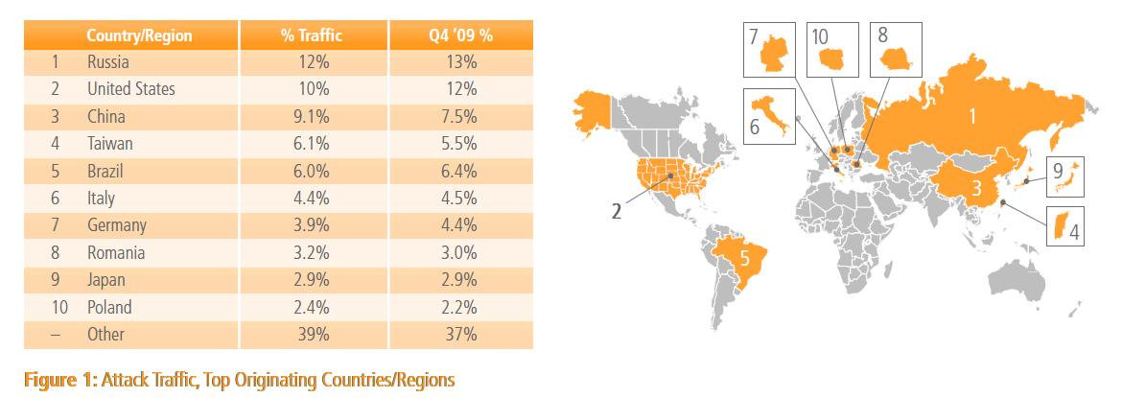
Top Attack Countries (Akamai Agents)
Notes:
11
US, Russia, and China top hitters for queries, but we have also seen more application layer attacks from countries like:
Turkey, Korea, and Mexico

Slide 12
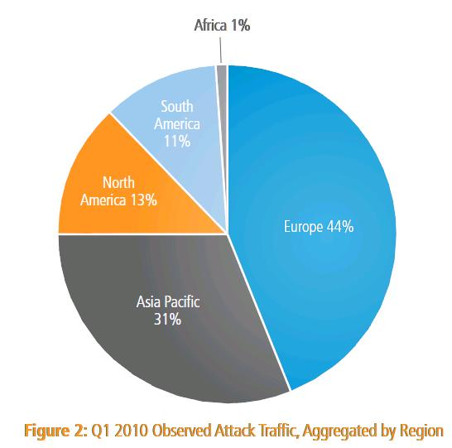
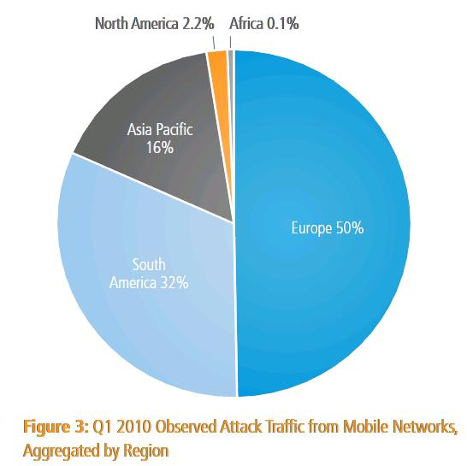
Top Attack Regions (Akamai Agents)
Europe 44% Overall
Europe 50% of Mobile
Notes:
12
It is interesting that in aggregate, Europe actually accounted for 44% of overall attack traffic viewed by Akamai agents.
And, for attack traffic from Mobile ASN’s, 50% of that mobile traffic came from Europe as well.

Slide 13
A Note On Mobile Connectivity
Global Mobile Providers | % > 1 Mbps | % > 2 Mbps | % > 5 Mbps | % > 10 Mbps
Average Connection Speed | 32%¹ | 13%¹ | -- | --
Maximum Connection Speed | -- | 76%¹ | 30%¹ | 6%¹
The GSM Association reports that global Mobile Broadband connections roughly doubled during 2009 to 200 million. By the end of 2010, they estimate this will reach 342 million global connections, with 120 million in Europe, 116 million in the Asia Pacific region, and 58 million in North America. ²
¹ Akamai ² GSM Association
Notes:
13
Mobile Represents a Growing Source of Threat for new DDoS and web application attack varieties
http://www.gsmworld.com/newsroom/press-releases/2010/4621.htm

Slide 14

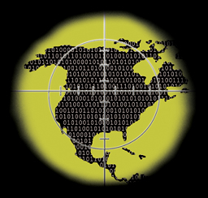
July 4 2009 DDoS Attack Observed Attack Profile
Type of Attack – Brute Force DDoS
The largest coordinated DDoS cyber attack against US Government Websites
HTTP Resource Drain attack
Sourced primarily from compromised Korean computers
Intensity of Attack
1,000,000+ hits per second and ~200 Gbps aggregate attack traffic (US Gov Only)
One website received 8 years of traffic in a day
All Traffic Logged for Akamai Customers
64 Billion Log Lines
13 TB of uncompressed log data (400+ Gigs of Compressed logs)
“Between the volume of the requests and their frustrating nature, a Web site with few servers or limited bandwidth can quickly be taken down. Others with greater physical and financial resources can take the punishment. That may explain why high-volume Web sites such as those belonging to the White House, the Pentagon and the New York Stock Exchange were able to withstand such attacks with barely a hiccup, while the Federal Trade Commission's and the Transportation Department's were knocked offline." - Paul Wagenseil, Fox News
Notes:
Unprecedented Size and Connectivity, 1M+ Hps, 200+ Gbs from 308k+ Zombies,
Although it used well defined attack vectors
Types of Attack: HTTP, UDP, ICMP, SYN Flood
Unprecedented
Size & Scope: Largest DDoS against US Government Websites Ever
Speed to Deploy: Compiled July 3rd, Attack July 4th, recruited ~75,000 Zombies per day while attacking
Geographic concentration: Korean speaking
Target changes during the attack
Responsibility for the Attack is Yet to be Established, US Government Sites on Akamai Remained Available
“Unsophisticated Attack”? Total Targets– 48 sites
33.33% (16 of 48) - US Government Sites
47.91% (23 of 48) – Government Sites (US + Korea)
56.25% (9 of 16)- of US Government Sites on Akamai
27.08% (13 of 48)- of Total Sites on Akamai

Slide 15
July 4, 2009 DDoS Attack
Times Above Previous Peak Traffic
598x
369x
39x
19x
9x
6x
SITE DOWN before Akamai
Customer – PROTECTED
U.S. Government Customer 1
U.S. Government Customer 2
U.S. Government Customer 3
U.S. Government Customer 4
U.S. Government Customer 5
U.S. Government Customer 6
New U.S. Government Customer
Peak Traffic
124 Gbps
32 Gbps
9 Gbps
9 Gbps
2 Gbps
1.9 Gbps
0.7 Gbps
“Between the volume of the requests and their frustrating nature, a Web site with few servers or limited bandwidth can quickly be taken down. Others with greater physical and financial resources can take the punishment. That may explain why high-volume Web sites such as those belonging to the White House, the Pentagon and the New York Stock Exchange were able to withstand such attacks with barely a hiccup, while the Federal Trade Commission's and the Transportation Department's were knocked offline." - Paul Wagenseil, Fox News
Notes:
Type of Attack – Brute Force DDoS
The largest coordinated DDoS cyber attack against US Government Websites
HTTP Resource Drain attack
Sourced primarily from compromised Korean computers
Intensity of Attack
1,000,000+ hits per second and ~200 Gbps aggregate attack traffic (US Gov Only)
One website received 8 years of traffic in a day
All Traffic Logged for Akamai Customers
64 Billion Log Lines
13 TB of uncompressed log data (400+ Gigs of Compressed logs)

Slide 16
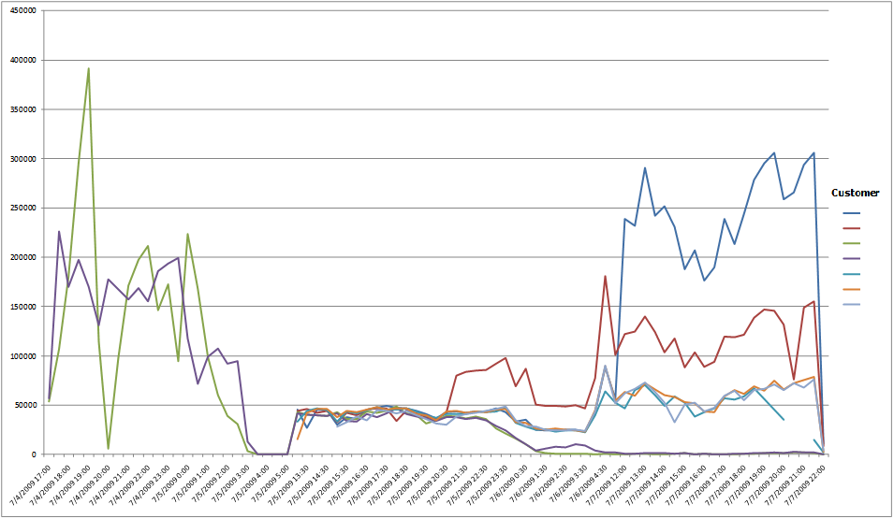
Akamai Analysis of Log Data Top Attacking IP Address Over Time
July 4th – Attacks focused on two sites
July 5th – Attacks spread to include 5 other sites. Even traffic spread.
July 5th (late) – Attack shifts bulk of attack to 2 new sites
July 7th (late) – Attack Ends
All Targeted US Government Websites (not using Akamai) Went Down!
Notes:
Unsophisticated Attack? Maybe..
There is a lot of debate as to whether this attack was sophisticated or unsophisticated. It bears the marks of both.
This graph demonstrates one of the most interesting aspects of sophistication related to this attack, in that the attack adapted itself over time.
Top attacking IP:
As we reacted, the attacker reacted
This attacker was cut off three days before the overall DDoS ended
Initially targeted two sites, stopped and we thought it might be done
Restarted across multiple sites, evenly distributed
Readjusted to focus brunt of attack on fewer targets

Slide 17
Unique Hostile IPs Over Time
Spike 1
Spike 3
Spike 2
97,882 Unique IP’s in 30 mins
Few common attackers between spikes: (Only 4,284 IP’s Shared Across all Spikes)
Much Larger Then Any Public Estimates
Notes:
You Cannot Block Fast Enough
Many or Few Computers? One of our questions when analyzing this attack was “Is this attack coming from a lot of Zombied computers, or is it coming from some Superfarm of data centers built specifically for the attack”
Public Estimates ranged from 20-60k, but it turns out it was ~308k (5 times more), much larger than estimates
Three waves of attack
IP’s Overlapping very little between waves
Recruited 50-75k Zombies / day before the malware was prevented from spreading more from compromised computers
Traditional Methods of Blocking an attack of this power directed at your infrastructure will not work.
Firewalls at Max, and other services impacted.

Slide 18
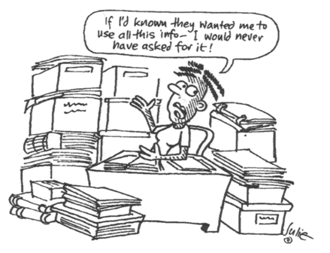
Crunching The Data
Notes:
18
1) Pull Logs from 65,000 servers (raw data ~14 TB), 2) Aggregate logs into 30 minute chunks from “unique” players, 3) Load into fast servers with good indexes, 4) Run analysis, 5) Make analysis repeatable and flexible for next set of attacks
Things That Did Not Work:
Ruby Scripting (initial try was going to take months (plural) to upload and process the data
Perl Scripting was much faster, but still looked like it was going to take about a month to process the 64 billion log lines
Tried doing crunching during mySQL DB load, but that was also going to take about a month based on test rates
Uncompressing files before processing (on the large data set, it did not turn out to be feasible)
What DID Work:
Ubuntu machine with Four 2 GHz processors w/ 32 Gigs of RAM (and we use it)
RAID5 Fiber Channel accessed Disk array of 32 disks with usable capacity of 13 TB of disk space
C Program (took about 3 days to run)
- Processed files compressed
- Aggregated data in memory by IP, Request URL, User-Agent, Referrer, and 30 minute time block
- Broke down initial data aggregation into multiple processor to utilize all 4 CPU’s simultaneously
Load raw aggregated data into tables (pretty fast for the 500M rows)
Final data aggregation of duplicate 30 minute blocks to account for fact that data might not have been fully sorted
Tips:
Add indexes after data is loaded
Tokenize repeated data for speedier queries (like URL’s, UA, IP’s)
Get lots of RAM, CPU, and disk storage, and leverage the first two heavily.
Script for easy recreation of process and data structures
Future:
- We know we can optimize our disk configuration further for the DB usage of disk, but has not been critical yet

Slide 19

Future Outlook and Innovation
Notes:
19
Mobile Threat Sources Increasing
Application Layer Attacks Increasing (WAF)
More sophisticated Attacks that combine multiple attack vectors and trickier signatures to identify
TrustedSource Heurestics Added into the mix for mitigation
Automatic rate limiting traffic from IP’s consuming too many resources
People services to help mitigate and stay ahead in the arms race (be better prepared and make others look like better targets)
Defenses within the DMZ are No Longer Sufficient
Distributed Threat Requires a Distributed Mitigation
Shared Risk to the DMZ
Separate Web Infrastructure from other Services
Akamai ITC Security to Frontend your Web Infrastructure
Identify Critical & Non-Critical Applications
Integrate with the Security Operations Center (SOC)
Develop a Playbook
Share Key Player Contacts
Run Tabletop Exercises

Slide 20
Thank you
Notes:
Available for Q&A and group discussion

Slide 21













Akamai Architecture Operational View – OV-1
Akamai Network
65,000+ Servers
1500+ Locations
950+ Networks
70+ Countries
Data Center
Web Servers
Fire
Wall
Edge Servers
Database
Compression
Network Storage
Load Balancer
Transaction Server
WAF
EDNS
Internet
Directory/ Policy Server
Akamai
Site Shield
Network Storage
Edge Servers
Legacy
Systems
App Servers
DNS Server
End Users
Back-Up Site or Load Balanced Multi-Data Center
Security Availability Scalability Visibility Resource Savings Performance
Notes:
Leveraging the Cloud For Security
A Platform Built with Defense In Mind
Comprehensive Security Capabilities from the IP level to, to DNS, to Application Layer 7 Inspection
Expanding Platform of Cloud based capabilities
Good Security and Risk Management are NOT JUST about technology, but require Situational Awareness, Compliance, Availability, and Performance.

Slide 22




































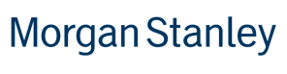








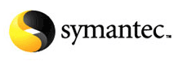









Broad adoption across verticals
If you’re on-line you’re using Akamai
Retail & Travel
Over 400 Global Retailers
50 of the top 50 U.S. Retailers
Over 125 Global Online Travel Sites
Media & Entertainment
30 of the top 30 M&E companies
Finance
9 of top 15 Global Banks
Technology
The top five anti-virus companies

Slide 23











































US Government Customers 12 of 15 Cabinet Agencies

